Slide 1
Distributed Operating Systems

Slide 2
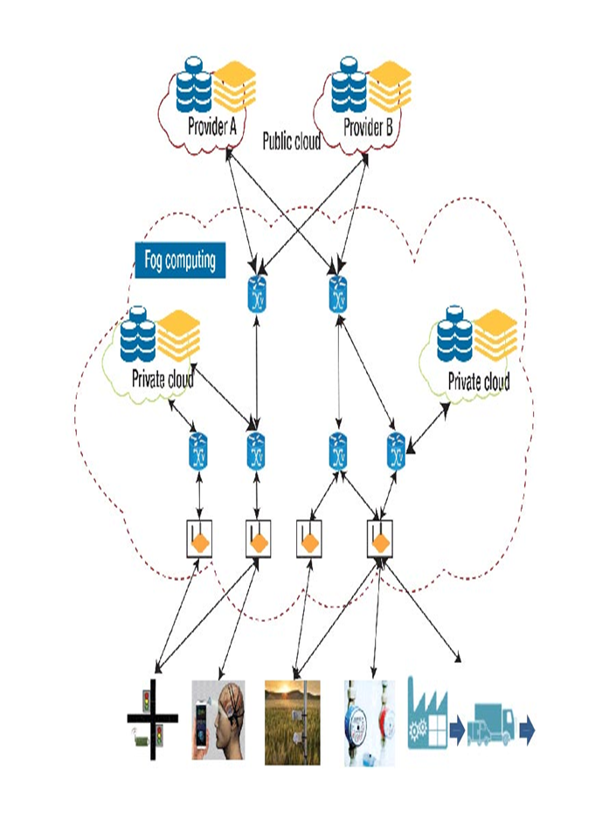
Introduction to Distributed Systems and Their Architecture
Definition of Distributed Systems
A Distributed System (DS) is a collection of independent computers (nodes) that appear to users as a single coherent system.
Each computer has its own processor and memory.
They are connected through a network.
They coordinate by passing messages.
Example: Cloud services (Google Drive), Hadoop clusters, online banking systems.

Slide 3
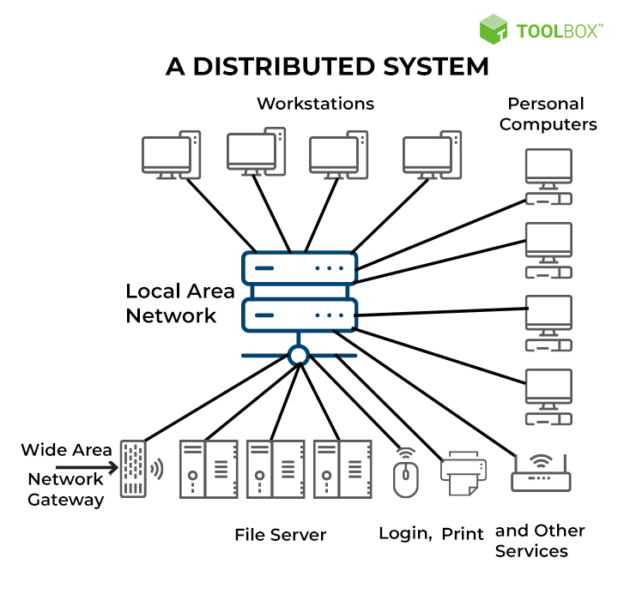
Introduction to Distributed Systems and Their Architecture
A Distributed System (DS) is a collection of independent computers (nodes or hosts) that work together as a single, unified system to the end user.
These nodes communicate and coordinate their actions only through message passing over a network (e.g., LAN, WAN, Internet).
Key Idea:
The distribution of resources is hidden from users — the system looks like one single computer.

Slide 4
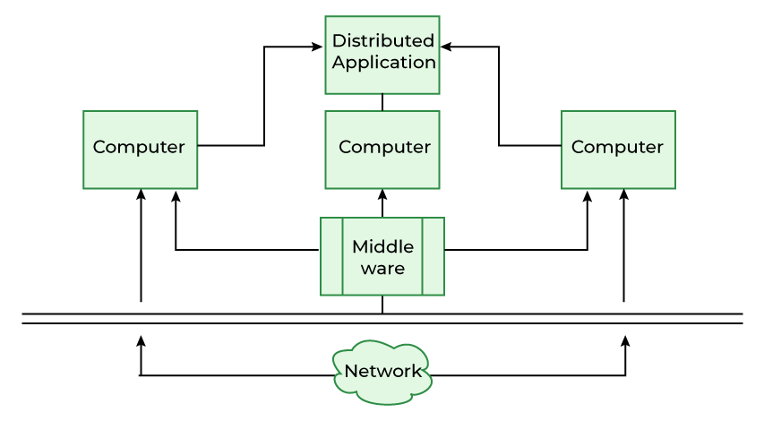
Core Components of a Distributed System
Nodes/Processes:
Independent machines (or processes) with their own CPU, memory, and storage.
Examples: individual servers in a data center, IoT devices, virtual machines, etc.
Communication Network:
Connects all the nodes.
Enables message passing — the primary mode of coordination.
Example: Ethernet, Internet, or Infiniband.
Middleware:
Software layer that provides a common interface and hides complexities of communication, failures, and heterogeneity.
Examples: CORBA, Java RMI, gRPC, Kafka, etc.
Distributed Applications:
User-level software built on top of middleware to perform useful tasks such as file sharing, data processing, or database services.

Slide 5
Comparison: Distributed System vs. Centralized System
Aspect | Centralized System | Distributed System
Control | Single central node | Multiple independent nodes
Resource Location | All resources local | Resources distributed
Failure | Single point of failure | Fault-tolerant
Scalability | Limited | Highly scalable
Communication | Local communication | Network-based communication

Slide 6
Example Scenarios:
Internet Search Engines: Thousands of servers work together to process search queries.
Cloud Computing: Amazon AWS, Microsoft Azure — distribute computation and storage globally.
Hadoop Cluster: Distributes large data processing jobs across multiple machines.
Blockchain: A distributed ledger replicated across many nodes with no central control.

Slide 7
Characteristics of Distributed Systems:
Multiple Components: Several computers work together.
Resource Sharing: Hardware, software, and data are shared.
Scalability: Can grow horizontally by adding more machines.
Concurrency: Many processes run simultaneously.
Transparency: Users should not see the complexity of distribution.
Fault Tolerance: System should continue functioning even if some nodes fail.

Slide 8
Goals of Distributed Systems
Transparency (make distribution invisible to the user):
Access Transparency: Same operations for local/remote resources.
Location Transparency: Users don’t need to know where resources are located.
Replication Transparency: Multiple copies of resources appear as one.
Concurrency Transparency: Multiple users can access resources simultaneously.
Fault Tolerance Transparency: System masks hardware/software failures.
Performance: High throughput and low latency.
Scalability: Ability to add more nodes easily.
Openness: Interoperability with different hardware/software platforms.
Reliability: Ensure continuous service despite failures.

Slide 9
Advantages of Distributed Systems.
Resource Sharing (files, printers, storage, compute power).
Scalability (easy to add more machines).
Fault Tolerance (failure of one node doesn’t crash system).
Performance (parallel execution improves efficiency).
Flexibility (works across heterogeneous platforms).

Slide 10
Challenges in Distributed Systems:
Scalability Issues: Managing large networks, consistency, and replication.
Fault Tolerance: Detecting and recovering from failures is complex.
Heterogeneity: Different hardware, OS, and networks must cooperate.
Security: Authentication, access control, and secure communication.
Concurrency Control: Avoiding conflicts when multiple users access shared data
Transparency Maintenance: Hiding complexity while ensuring performance.

Slide 11
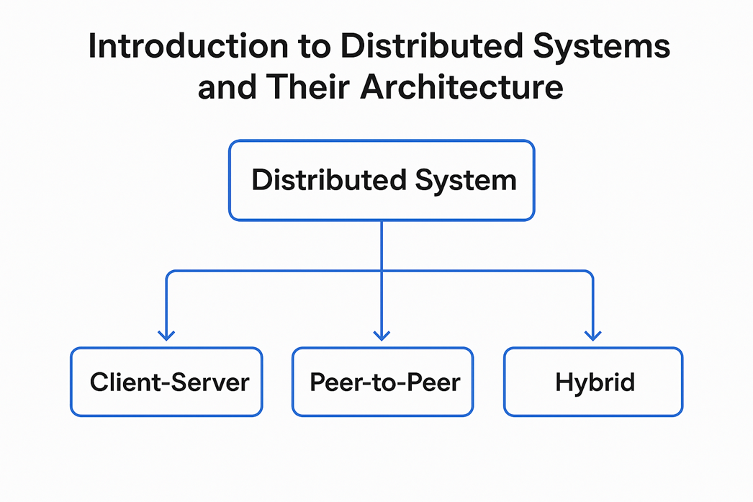
Architectural model :
An architectural model defines how components (processes, nodes, and communication mechanisms) of a distributed system are organized and interact to provide system services.
It specifies:
System structure (how components are arranged)
Control distribution (centralized or decentralized)
Communication patterns (client-server, peer-to-peer, etc.)
Data management (how data is shared and synchronized)
Main Architectural Models
Distributed systems can be organized into three broad styles:
Client–Server Model
Peer-to-Peer (P2P) Model
Hybrid Model

Slide 12
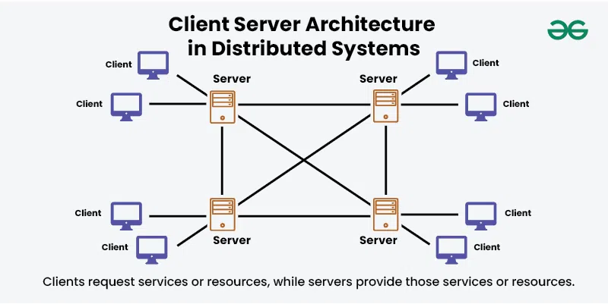
Architectural Models of Distributed Systems
a) Client–Server Model
The server provides services or resources.
The client requests and uses those services.
They communicate through a network using standard protocols like HTTP, FTP, RPC, etc.
Centralized control.
Examples: Web servers, email servers.
Advantage: Simple to design.
Disadvantage: Single point of failure, scalability issues.
[ Client 1 ] [ Client 2 ]
| |
|--- Requests ---> [ Server ]
|<-- Responses --- |

Slide 13
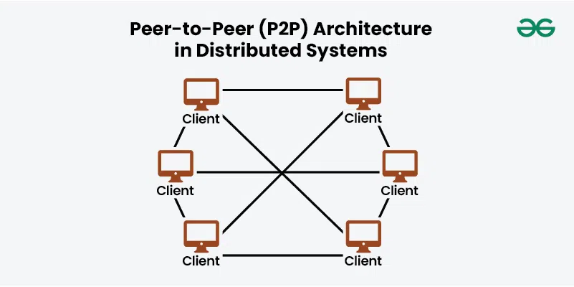
Architectural Models of Distributed Systems
b)Peer-to-Peer (P2P) Model
In this model:
Each node (peer) acts as both client and server.
All peers are equal participants, sharing resources directly without centralized coordination.
No central authority.
Examples: BitTorrent, blockchain, Skype (early versions).
Advantage: Scalable, fault-tolerant.
Disadvantage: Complex resource management and security.
[Peer A] <--> [Peer B] <--> [Peer C]
^ | |
|_____________|______ |

Slide 14
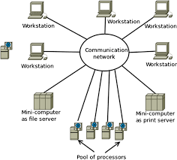
Architectural Models of Distributed Systems
c) Hybrid Model
Combines features of Client–Server and P2P models.
Often uses a central server for coordination (indexing, authentication), but data exchange happens directly between peers.
Combines Client-Server and P2P.
Example: Modern file-sharing (e.g., Napster, Spotify)Cloud gaming platformsContent delivery networks (CDNs)
Advantage: Balances scalability with centralized control.
[ Central Server ]
/ | \
Index | Authentication
/ | \
[Peer 1] <--> [Peer 2] <--> [Peer 3]

Slide 15
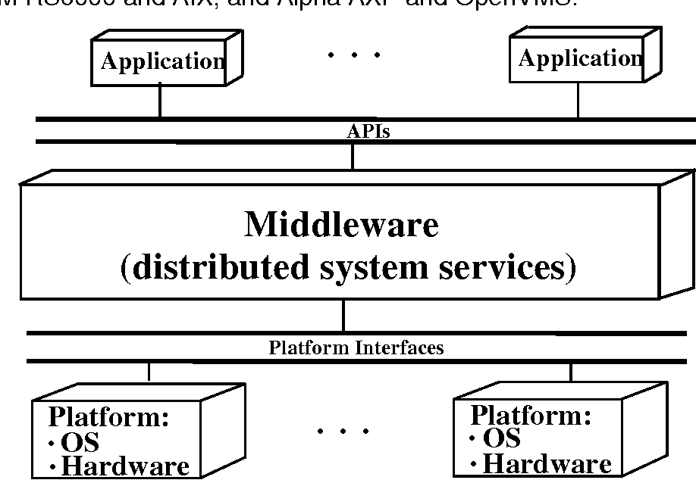
Middleware and its Role
Middleware = software layer that lies between the OS and distributed applications.
Middleware is a software layer that connects different applications, systems, and databases, acting as a "bridge" to facilitate communication, data exchange, and common services like security and authentication.
Its main role is to simplify development by handling the complex task of integration, allowing developers to focus on building core application features rather than connecting disparate technologies.
Middleware is essential in modern IT for creating seamless, integrated systems in complex environments like multi-cloud and containerized architectures.
Functions of Middleware:
Provides abstraction: hides complexity of distribution.
Supports communication: message passing, RPC, RMI.
Ensures security: authentication, encryption.
Offers services: naming, directory, load balancing, transaction management.
Examples:
CORBA (Common Object Request Broker Architecture)
Java RMI (Remote Method Invocation)
gRPC (Google RPC)

Slide 16
Middleware and its Role
Role of middleware:
Connects and communicates:
It enables disparate applications, even those built on different technologies, to communicate with each other by translating data and managing requests.
Simplifies development:
By handling complex communication and integration tasks, it frees developers to concentrate on creating unique application features and functionality.
Provides common services:
Middleware provides a set of common services that applications can use, such as authentication, API management, and message queuing.
Offers security:
It can establish secure connections, manage authentication, and handle data encryption between applications and backend systems.
Manages data:
It handles data management tasks, ensuring data can be exchanged smoothly and efficiently, even across geographical distances.
Ensures consistency:
It provides a consistent and standardized way for applications to interact, creating a unified service for users and ensuring interoperability between components.
Facilitates scaling:
In cloud-native and containerized environments, middleware helps make it cost-effective to develop and run applications at scale.

Slide 17
Distributed Process Scheduling & Load Balancing

Slide 18
Distributed Process Scheduling & Load Balancing
Introduction
In a Distributed System, many computers (nodes) are connected via a network and share computational tasks.
Each node has its own processor and memory, but to achieve optimal performance, the system must:
Distribute workload efficiently
Avoid idle processors while others are overloaded
Minimize execution time and maximize throughput
Hence, Distributed Process Scheduling and Load Balancing are key components.

Slide 19
Need for Scheduling in Distributed Systems
Why Scheduling is Needed:
Uneven Load Distribution: Some nodes may be overloaded while others remain idle.
Resource Utilization: Proper scheduling ensures maximum use of available CPUs, memory, and network.
Performance Improvement: Reduces response time and improves throughput.
Scalability: Efficient scheduling helps systems scale with more nodes or jobs.
Fault Tolerance: Reassigns tasks if a node fails.
Energy Efficiency: Avoids overuse of certain nodes to save energy.

Slide 20
Scheduling Strategies:
Scheduling can be classified based on where and how scheduling decisions are made.
A. Static Scheduling
Decisions are made at compile-time or before execution.
Tasks are pre-assigned to processors.
No runtime adaptation.
Suitable for predictable and homogeneous systems.
Example: Round Robin, Weighted Distribution. Limitation: Cannot adapt to node failures or runtime load changes.
B. Dynamic Scheduling
Decisions made during execution, based on current system state.
Tasks may migrate between nodes at runtime.
Suitable for heterogeneous and unpredictable systems.
Example: Adaptive Load Sharing, Task Migration Algorithms. Limitation: Requires communication overhead and monitoring.

Slide 21
Load Balancing in Distributed Systems:
Load Balancing means evenly distributing workload among nodes to avoid overload or idleness.
Objectives:
Improve overall system performance
Reduce job waiting time
Enhance resource utilization
Provide fault tolerance and reliability

Slide 22
Load Balancing in Distributed Systems
Load Balancing means evenly distributing workload among nodes to avoid overload or idleness.
Load Balancing Policies
Load balancing algorithms are typically defined by four policies:
Policy Type | Description | Purpose
Transfer Policy | Decides when to transfer a task — i.e., when a node is overloaded. | Initiate load transfer
Selection Policy | Decides which task(s) should be transferred. | Minimize transfer cost
Location Policy | Determines where to transfer the selected task — i.e., which node should receive it. | Find appropriate destination
Information Policy | Specifies how system status is collected and how often. | Update load information to make scheduling decisions

Slide 23
Types of Load Balancing:
Type | Key Feature | Example Algorithms
Static | Fixed distribution decided before execution | Round Robin, Random, Hash-based
Dynamic | Decisions made during runtime based on load info | Threshold, Sender-Initiated, Receiver-Initiated

Slide 24
Types of Load Balancing:
Static Load Balancing
Definition
Static load balancing means the distribution of tasks is decided before execution — at compile-time or task submission time. Each node’s capability and workload are assumed to be known in advance.
How It Works
The system has complete information about nodes (processing power, speed, memory).
Tasks are assigned deterministically (not changed later).
Once assigned, the task stays on the same node — no task migration.
Algorithm | Description | Example Scenario
Round Robin | Tasks distributed in circular order among nodes. | Equal-sized jobs on identical processors
Random Allocation | Each new task assigned to a randomly chosen node. | Cloud task distribution for uniform resources
Weighted Round Robin | Nodes assigned weights based on capacity; heavier nodes get more tasks. | Heterogeneous servers (some faster CPUs)
Hash-based Distribution | A hash function determines task-to-node mapping. | Web caching or DNS load balancing

Slide 25
Types of Load Balancing: Static Load Balancing
Round Robin Load Balancing
Definition
Round Robin is a static load balancing technique where tasks (or requests) are assigned to each server or node in a circular order, one after another.
After the last node receives a task, the next task goes back to the first node, forming a continuous rotation — like dealing cards to players.
How It Works
Suppose there are N nodes: Node₁, Node₂, ..., Nodeₙ.
The scheduler maintains a pointer to the last node assigned.
Each new task/request is sent to the next node in sequence.
Once all nodes have been assigned, the cycle repeats.
Example
Let’s say you have 3 servers (A, B, C) and 6 incoming tasks.
After C, the cycle restarts with A.
Task | Assigned To
Task 1 | Server A
Task 2 | Server B
Task 3 | Server C
Task 4 | Server A
Task 5 | Server B
Task 6 | Server C

Slide 26
Types of Load Balancing: Static Load Balancing
Hash-based distribution :
Hash-based distribution (also called hash-based load balancing or consistent hashing) is a static load balancing technique where the destination server (or node) for a request is determined by applying a hash function to a key — such as the client IP address, session ID, or file name.
Instead of assigning tasks sequentially (like Round Robin), a mathematical hash function decides which node will handle each task.
Basic Idea
The hash of a unique value (like user ID or file name) determines the server number.
Server = hash(key) mod N
where
key = identifying value (e.g., client IP, filename, userID)
N = number of available servers/nodes

Slide 27
Types of Load Balancing: Static Load Balancing
How It Works (Step-by-Step)
Let’s say we have 4 sHash-Based Distribution (Hashing Load Balancing)
servers and each incoming request has a client ID.
So,
Client 101 → Server 1
Client 102 → Server 2
Client 103 → Server 3
Client 104 → Server 0
Each client’s request always goes to the same server, as long as the hash function and number of servers remain the same.
Client ID | Hash(key) | Server = hash(key) mod 4
101 | 9 | 9 mod 4 = 1
102 | 10 | 10 mod 4 = 2
103 | 11 | 11 mod 4 = 3
104 | 12 | 12 mod 4 = 0

Slide 28
Types of Load Balancing:
Dynamic Load Balancing
Definition
Dynamic load balancing makes real-time decisions during execution. Tasks can move (migrate) from one node to another depending on current system load
How It Works
Each node periodically monitors its load (CPU, queue length, memory).
Nodes exchange information about their load status.
Tasks are transferred between nodes to maintain balance.
Types of Dynamic Load Balancing Algorithms
Algorithm Type | Initiated By | Description
Sender-Initiated | Overloaded node | Overloaded nodes send tasks to underloaded nodes.
Receiver-Initiated | Underloaded node | Idle nodes request work from busy nodes.
Symmetric / Hybrid | Both | Both overloaded and underloaded nodes can initiate transfers.

Slide 29
Types of Load Balancing: Dynamic Load Balancing
Sender-Initiated Approach
Definition
In the sender-initiated approach, the process of load balancing is initiated by an overloaded node (sender). When a node detects that it has too many tasks, it tries to offload (send) some of its work to underloaded nodes.
How It Works (Step-by-Step)
Each node monitors its load (CPU usage, queue length, etc.).
If a node’s load exceeds a threshold, it becomes a sender.
The sender searches for a receiver (a lightly loaded node).
It transfers one or more tasks to the receiver.
Both update their load status.
Example
Let’s say:
Node A = overloaded
Node B, C = underloaded
Process:
Node A (sender) → sends task → Node B (receiver)

Slide 30
Types of Load Balancing: Dynamic Load Balancing
Receiver-Initiated Approach
Definition
In this approach, the underloaded (idle) nodes initiate the load balancing. When a node detects that it is idle or lightly loaded, it requests tasks from overloaded nodes.
How It Works (Step-by-Step)
Each node monitors its current load.
If a node’s load is below a threshold, it becomes a receiver.
It searches for sender nodes (overloaded ones).
Once found, it requests and receives one or more tasks.
Both nodes update their load status.
Example
Let’s say:
Node A = overloaded
Node B = idle
Node B (receiver) → requests task → Node A (sender)

Slide 31
Types of Load Balancing: Dynamic Load Balancing
Symmetric (Hybrid) Approach
Definition
The symmetric or hybrid approach combines sender-initiated and receiver-initiated strategies. Both overloaded nodes and underloaded nodes can initiate load balancing depending on their status.
How It Works (Step-by-Step)
Every node continuously monitors its load.
If a node is overloaded, it acts as a sender and looks for receivers.
If a node is underloaded, it acts as a receiver and looks for senders.
Task transfer occurs when both agree (handshake).
This dual initiation keeps load balanced efficiently.
Example
Node A (sender) ↔ Node C (receiver)
Node | Load Level | Action
Node A | High | Acts as sender
Node B | Medium | Idle (no action)
Node C | Low | Acts as receiver

Slide 32
Types of Load Balancing:
Hierarchical Load Balancing (Hybrid Approach)
Definition
Hierarchical Load Balancing is an advanced hybrid approach used in large distributed systems where nodes are organized in multiple levels (hierarchies) — such as clusters, data centers, or regions — and load balancing decisions are made at each level.
It combines the features of:
Centralized Load Balancing (coordination at higher levels)
Distributed Load Balancing (autonomy at lower levels)
Goal: Achieve scalability, fault tolerance, and efficiency in very large systems.
Instead of having one global scheduler for the entire network, the system is divided into smaller groups (clusters).
Each group has its own local load balancer, and a global coordinator manages the groups.

Slide 33
Types of Load Balancing:
Hierarchical Load Balancing (Hybrid Approach)
Architecture / Structure
Hierarchical load balancing is structured as multiple levels of control, such as:
🔸 Level 1 (Local Level)
Individual nodes or servers are managed by a Local Scheduler (or Local Load Balancer).
Each local scheduler balances load within its own cluster.
🔸 Level 2 (Regional / Cluster Level)
Each cluster has a Cluster Manager or Regional Balancer.
It monitors the load of all local schedulers in its cluster.
It can transfer tasks between local nodes within the same cluster.
🔸 Level 3 (Global Level)
A Global Scheduler (or Root Balancer) oversees multiple clusters.
It redistributes load between clusters when one cluster becomes overloaded.
[ Global Scheduler ]
│
┌─────────────┼─────────────┐
[Cluster A] [Cluster B] [Cluster C]
│ │ │
[Nodes A1,A2] [Nodes B1,B2] [Nodes c1 c2]

Slide 34
Load Balancing in Distributed Systems (Policies)
Definition
Load Balancing is the process of distributing workloads evenly across multiple nodes (processors, servers, or machines) to:
Improve system performance,
Avoid overload on any node,
Maximize resource utilization,
Minimize response time.
Goal :To ensure that no single node is heavily loaded while others remain underutilized.
1. Transfer Policy
🔸 Definition :Determines when a process (or task) should be transferred from one node to another.
🔸 Purpose: Decides the trigger condition for load redistribution — i.e., when the system considers a node as “overloaded” or “underloaded”.
🔸 Common Strategies
Threshold-based: If the load on a node exceeds a certain threshold → initiate transfer.
Periodic Checking: Check load at regular intervals.
Demand-driven: Transfer is initiated only when a request arrives.

Slide 35
2. Selection Policy
🔸 Definition: Determines which process or task should be transferred for load balancing.
🔸 Purpose: To select an appropriate task that will reduce the load without disrupting system performance.
🔸 Selection Criteria
The process should be lightweight to move (small state size).
It should be in a transferable state (not waiting for I/O).
Minimize migration cost.
3. Location Policy
🔸 Definition: Determines where (to which node) the selected process should be transferred.
🔸 Purpose: Finds a suitable destination node that is underloaded or least loaded.
🔸 Strategies
Random: Choose a random node.
Polling: Ask a few nodes about their load before choosing.
Centralized Directory: Maintain a list of underloaded nodes.
Heuristic-based: Choose node with minimum queue length or CPU usage.

Slide 36
4. Information Policy
🔸 Definition: Determines what, when, and how load information is collected and distributed across nodes.
🔸 Purpose :Keeps track of each node’s load status for making accurate balancing decisions.
🔸 Information Collection Methods
Periodic: Nodes exchange load info at fixed intervals.
On-demand: Only when load changes significantly.
Broadcast-based: Nodes broadcast their load to others.
Centralized: A single coordinator gathers and stores load information.
🔸 Trade-off
More frequent updates → higher accuracy but more communication overhead.

Slide 37
NFS – Network File System
1. Introduction
Network File System (NFS) is a distributed file access protocol that allows users to access remote files as if they were local.
Developed by Sun Microsystems (1984), it became a standard for UNIX-like systems.
NFS operates over a Client–Server model, using Remote Procedure Calls (RPC) for communication.
It provides transparent, location-independent access to files over the network.
Key Principle:
“Files located on remote machines can be accessed just like local files, with the same system calls and interfaces.”

Slide 38
NFS Architecture Overview
Architecture Type: Client–Server Model
Components:
NFS Server
Stores exported directories.
Runs daemons: nfsd, mountd.
NFS Client
Mounts remote directories.
Runs daemons: biod, rpcbind.
Network Layer
Handles communication using RPC over TCP/UDP.

Slide 39
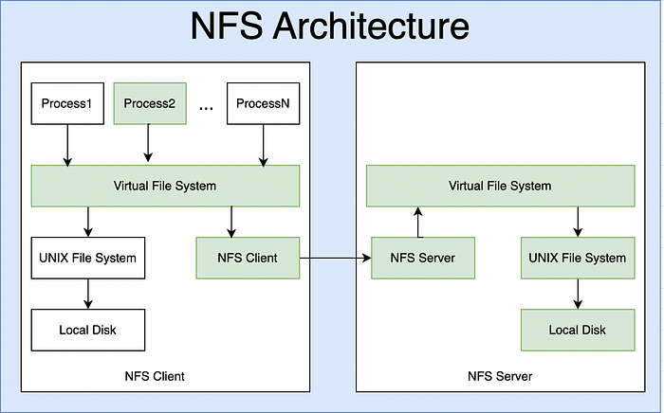
NFS Architecture
NFS is structured as a multi-layered architecture to separate file system interface, client-side functions, and network communication.

Slide 40
NFS Architecture
NFS is structured as a multi-layered architecture to separate file system interface, client-side functions, and network communication.
NFS Client
Resides on the client machine.
Allows local users/processes to transparently access files on a remote server.
Main Modules:
VFS (Virtual File System): Provides abstraction for different file systems (ext4, NFS, etc.).
NFS Client Module: Handles requests to remote files (open, read, write, close).
RPC Layer: Communicates with the NFS server using Remote Procedure Calls.
Cache Manager: Stores frequently accessed data to improve performance.
NFS Server
Runs on the host machine that shares its files.
Main Daemons:
nfsd: Handles actual NFS file requests from clients.
mountd: Manages mount requests and permissions.
rpcbind (or portmapper): Maps RPC program numbers to network ports.
Local File System: The physical file system (e.g., ext4, xfs) on the server.
Communication Mechanism
Remote Procedure Call (RPC)
NFS uses RPC over UDP or TCP for communication.
Each file operation (like read, write, getattr) is implemented as a remote procedure.
The client makes an RPC call → server executes it → returns result.
External Data Representation (XDR)
Ensures data format compatibility across different systems (e.g., little-endian vs big-endian).

Slide 41
NFS File Access Mechanism
A. Mounting Phase
Client contacts the mount daemon on the server.
Server verifies access permissions (based on /etc/exports file).
If permitted, server returns a file handle (a unique identifier for directory).
Client mounts the remote directory into its local file tree.
B. File Operation Phase
Once mounted:
User processes use normal system calls: open(), read(), write(), close().
The Virtual File System (VFS) layer determines if the file is local or remote.
If remote:
The NFS client converts the request into an RPC.
The RPC is sent to the server.
The NFS server performs the operation and returns results.
All operations (READ, WRITE, LOOKUP, CREATE, REMOVE, etc.) are handled as RPC calls.

Slide 42
Communication Using RPC and XDR
RPC (Remote Procedure Call)
Each NFS request is an RPC message to the server.
The server executes the operation and sends back the result.
XDR (External Data Representation)
Used to encode data in a machine-independent format.
Ensures interoperability between heterogeneous systems (e.g., big-endian vs little-endian).
Protocol Stack
Application
↓
VFS
↓
NFS Client Module
↓
RPC / XDR Layer
↓
TCP / UDP
↓
IP Layer

Slide 43
HDFS (Hadoop Distributed File System) Architecture
Introduction
HDFS stands for Hadoop Distributed File System.
It is the primary storage system used by Apache Hadoop to store and manage large datasets across multiple machines.
Designed to store very large files (GBs to TBs) reliably on a cluster of commodity hardware.
Key Design Goals:
High fault tolerance
High throughput
Scalability
Streaming data access
Portability across hardware

Slide 44
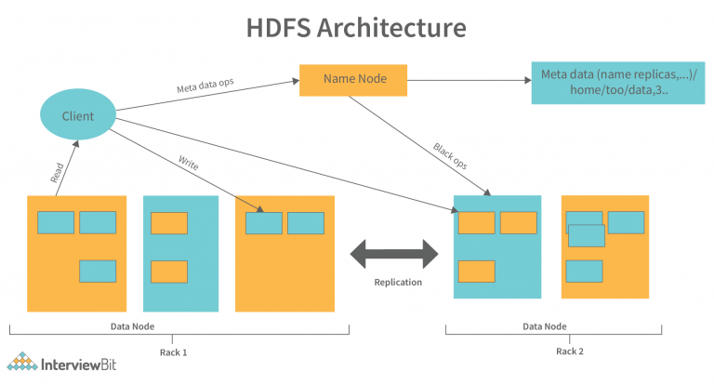
HDFS (Hadoop Distributed File System) Architecture
+----------------------------+
| Client |
+--------------+--------------+
|
| (Read/Write via API)
|
----------------------------------------------------------
| |
+----v-----+ +----v-----+ +----v-----+ +----v-----+
| DataNode | | DataNode | | DataNode | ... | DataNode |
| (Slave) | | (Slave) | | (Slave) | | (Slave) |
+-----------+ +-----------+ +-----------+ +-----------+
| | | |
+----------------------+--------------------+--------------------+
|
+-----v------+
| NameNode |
| (Master) |
+------------+

Slide 45
HDFS (Hadoop Distributed File System) Architecture
Core Components of HDFS
A. NameNode (Master Node)
The central metadata server of HDFS.
Manages the namespace of the file system (like a directory structure).
Stores metadata only, not actual data.
File names, permissions, ownership.
Mapping of file blocks → DataNodes.
Keeps all metadata in RAM for fast access.
Single point of coordination for all clients.
B. DataNode (Worker Node)
Stores the actual data blocks on the local disks.
Each DataNode periodically sends a heartbeat and block report to the NameNode.
Responsible for:
Serving read/write requests from clients.
Replicating blocks based on NameNode’s instructions.
Deleting/creating blocks as commanded.

Slide 46
HDFS (Hadoop Distributed File System) Architecture
Core Components of HDFS
C. Secondary NameNode
Often misunderstood — it’s not a backup NameNode.
Periodically merges the NameNode’s edit logs with the namespace image (FsImage) to prevent the log file from growing too large.
Helps in checkpointing, ensuring faster recovery after crashes.
D. HDFS Client
Interface between user applications and HDFS.
Provides APIs (Java, C, Python) for:
Creating, reading, deleting files.
Communicating with the NameNode and DataNodes.

Slide 47
HDFS (Hadoop Distributed File System) Architecture
Data Storage and Block Concept
Files in HDFS are divided into fixed-size blocks (default: 128 MB or 256 MB).
Each block is stored on multiple DataNodes for reliability.
Example: If a file is 512 MB and block size is 128 MB → File is split into 4 blocks (B1, B2, B3, B4).
Each block is replicated across 3 different DataNodes (default replication factor = 3).
Replication and Fault Tolerance
Replication Strategy
Default: 3 copies per block.
One replica on the same rack.
Another on a different rack for fault tolerance.
Third on another DataNode in the same/different rack.
Fault Recovery
If a DataNode fails:
NameNode detects it (missing heartbeat).
Creates new replicas of blocks on other DataNodes.
Ensures replication factor remains consistent.

Slide 48
HDFS (Hadoop Distributed File System) Architecture
Data Read Process
Steps:
Client contacts the NameNode to locate which DataNodes hold the file blocks.
NameNode returns a list of DataNodes for each block.
Client directly reads data from the nearest DataNode (data locality).
If a DataNode fails, the client automatically switches to another replica.
Data Write Process
Steps:
Client requests the NameNode to create a file.
NameNode responds with block allocation and suitable DataNodes.
Client writes each block to the first DataNode, which then pipelines the data to the next DataNodes for replication.
After successful writing and acknowledgment, NameNode updates metadata.
HDFS Communication Protocols
Uses TCP/IP for communication.
RPC (Remote Procedure Call) framework for client–NameNode and client–DataNode communication.
Heartbeat: DataNodes → NameNode (every 3 seconds default).
Block Reports: Sent periodically to update block information.

Slide 49
Remote Procedure Call (RPC)
Concept
Remote Procedure Call (RPC) is a communication mechanism that allows a program to execute a procedure (function) on a remote system as if it were local.
It abstracts network communication, allowing distributed systems to behave like a single unified system.
Motivation
In distributed systems, processes often need to communicate or share services.
Using message passing (send/receive) is complex and error-prone.
RPC simplifies this by:
Hiding details of network communication.
Making remote communication look like a simple function call.

Slide 50
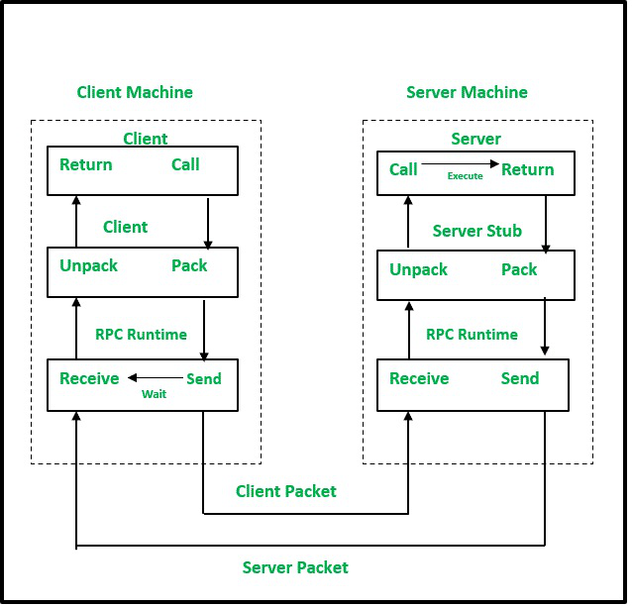
There are 5 elements used in the working of RPC:
Client
Client Stub
RPC Runtime
Server Stub
Server
Client: The client process initiates RPC. The client makes a standard call, which triggers a correlated procedure in the client stub.
Client Stub: Stubs are used by RPC to achieve semantic transparency. The client calls the client stub. Client stub does the following tasks:
The first task performed by client stub is when it receives a request from a client, it packs(marshalls) the parameters and required specifications of remote/target procedure in a message.
The second task performed by the client stub is upon receiving the result values after execution, it unpacks (unmarshalled) those results and sends them to the Client.

Slide 51
RPC Runtime: The RPC runtime is in charge of message transmission between client and server via the network. Retransmission, acknowledgement, routing, and encryption are all tasks performed by it. On the client-side, it receives the result values in a message from the server-side, and then it further sends it to the client stub whereas, on the server-side, RPC Runtime got the same message from the server stub when then it forwards to the client machine. It also accepts and forwards client machine call request messages to the server stub.
Server Stub: Server stub does the following tasks:
The first task performed by server stub is that it unpacks(unmarshalled) the call request message which is received from the local RPC Runtime and makes a regular call to invoke the required procedure in the server.
The second task performed by server stub is that when it receives the server's procedure execution result, it packs it into a message and asks the local RPC Runtime to transmit it to the client stub where it is unpacked.
Server: After receiving a call request from the client machine, the server stub passes it to the server. The execution of the required procedure is made by the server and finally, it returns the result to the server stub so that it can be passed to the client machine using the local RPC Runtime.

Slide 52
key components in RPC
Marshalling and Unmarshalling
Marshalling
The process of packing parameters and data structures into a network message before sending it over the network.
Ensures data compatibility between different systems (byte order, data format).
Unmarshalling
The process of unpacking received data at the destination side.
Converts it back into the original data types understandable by the receiving system.
Stubs in RPC
Client Stub
Represents the remote function locally.
Responsible for marshalling the procedure name, parameters, etc.
Server Stub (Skeleton)
Receives requests from client stub.
Unmarshals data, invokes the actual procedure, and sends response back.

